Slide 1

UNIT
DAY 18
02
WHERE WE ACTUALLY ARE
BUILT TO ORDER
AGENDA
REMINDERS
Phones into The Holding Cell
Laptops stay in your bag today
Bring a pen
The Warm Up
A Fresh Start
The Machine In The Box
Tracing Together
Your Turn
Say It In One Sentence
Before You Leave
RECOMMENDED LISTENING:
AREA ZERO – POKEMON SCARLET & VIOLET

Slide 2

THE WARM UP QUESTION
Back on Day 5 we hand-traced the Little Man Computer
  It fetched one instruction, did it, then went and got the next one
    What happened when we handed it an instruction it didn’t understand?
Notes:
They have done this before, on paper, in September. Say so.

Slide 3
THE WARM UP ANSWER
Answer: it stopped dead in its tracks, it couldn’t keep going
We’ll be exploring that concept today with a machine that has a few more words available to it
  We are not typing today just yet, we’re working on the fundamentals

Slide 4
A FRESH START
Unit 2 starts again today
Last week we moved too fast, and that’s on me
So we’re going back to the beginning, slower, and in a slightly different order
  Whatever you did or didn’t get last Thursday doesn’t count for anything
Notes:
Thirty seconds of honesty. They already know last week didn't land.

Slide 5

A FRESH START
Three things change from today
  We’re going to slow the pace and the content down
  I want to make sure these ideas come across to everybody
I expect you to pay attention
  I know that CS can be difficult to pick up, but you won’t ever do it if you aren’t trying and caring
  If you get stuck, don’t just ask me or a friend to do it, work it yourself
Today has no code in it at all
  Laptops stay in bags – fr fr

Slide 6
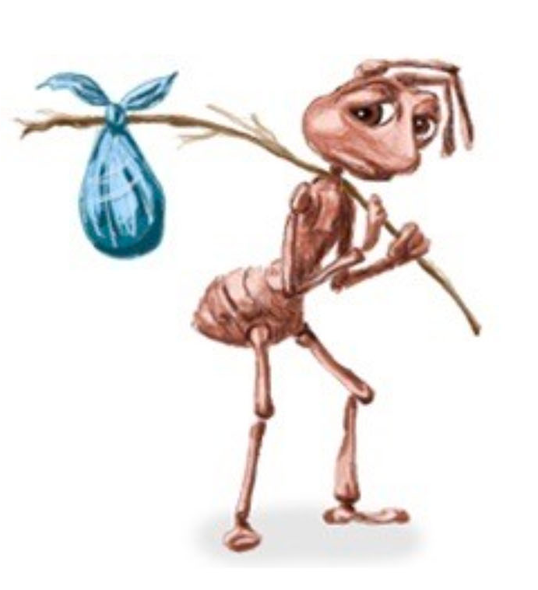
THE MACHINE IN THE BOX
A computer keeps things in labelled boxes called ‘variables’
  ‘variables’ represent locations in memory
  The label on the box is a name that we pick
  The box holds exactly one thing at a time
    It can only hold ONE thing
Putting something new in means the old thing is deleted permanently
Let’s put some boxes on the whiteboard
Notes:
boxes on the whiteboard

Slide 7
THE MACHINE IN THE BOX
The three rules for variables:
  You can assign one at a time, in the order the assignments are written
  A box holds one value, only the newest one
  If you copy what’s in a variable, and then change that variable later, the copy remains unchanged
Notes:
Rule three is the trap in Part A. Plant it now and don't mention it again.

Slide 8
TRACING TOGETHER
We’ll do the first three lines of this together, on the board
After each line, write down what every box holds
  What it holds right at that line, before you read on
1 SET score TO 0
2 SET bonus TO 5
3 ADD 3 TO score
4 ADD bonus TO score
5 SET bonus TO 1
6 SHOW score
7 SHOW bonus
Notes:
Fill the first three lines on the board. Write their wrong answers down too.

Slide 9
YOUR TURN
Finish Program A on your own, with each line getting a row on the table
Fill in what each box holds AFTER that line has run
Then write what the program shows on screen, in order
→ LAB 2-1 PART A
Notes:
Walk the room. Mark the blanks.

Slide 10
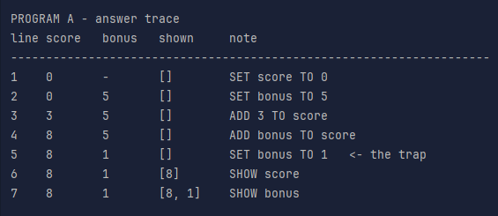
YOUR TURN
Answers first, then we run it and find out who was right
bonus changes AFTER score already took a copy of it
The copy doesn’t change what it is later
Notes:
Run day18_programs.py here. Let the machine settle the argument.

Slide 11
YOUR TURN
Program B does something new – lines 4 and 5 loop
Every time a line runs or re-runs, it gets a new row
  So line 4 will show up in your table three separate times
→ LAB 2-1 PART B
1 SET count TO 0
2 SET total TO 0
3 REPEAT WHILE count IS LESS THAN 3
4 ADD 1 TO count
5 ADD count TO total
6 END REPEAT
7 SHOW count
8 SHOW total

Slide 12
SAY IT IN ONE SENTENCE
Describe the whole program from question B in one sentence
  “It adds one to count” describes line 4 - I want the whole thing
Identifying what a code is for can often be the easiest way to learn from code, so being able to interpret it is important
→ LAB 2-1 PART C
Notes:
Take two answers aloud before they write. Don't judge either one.

Slide 13
SAY IT IN ONE SENTENCE
Same program as Part A, written in Python, and we’ll talk about Python next time
I know you haven’t been taught all of this, so you aren’t expected to understand all of it
One question: which line does the same job as ADD 3 TO score?
→ LAB 2-1 PART D
score = 0
bonus = 5
score = score + 3
score = score + bonus
bonus = 1
print(score)
print(bonus)

Slide 14
BEFORE YOU LEAVE
Give me your sheets
  None of this is graded, but it tells me where we’re at on Wednesday
Take a vocabulary sheet and keep it
  Read the six highlighted rows before next time - five minutes, no computer
Next time we’ll look at how variables work in the scope of a Python program

Slide 15

VOCAB TO REMEMBER
Trace - to follow a program by hand, one line at a time, writing down what changes
Value - a single piece of information. A number, or a piece of text
Sequence - instructions carried out in the order they’re written
All three are on your vocabulary sheet

